Slide 1

Evaluating Efficiency in Humanitarian Funding
A Data-Driven Framework for Monitoring Humanitarian Spending Efficiency
CMU Datathon 2026 | Team: Storm Breakers
Aravindhan Anbazhagan & Mohit Karangutkar
Notes:
“Hello everyone, we’re Team Storm Breakers. Our project is Evaluating Efficiency in Humanitarian Funding. The core idea is simple: when humanitarian funds are limited and needs are vast, how do we ensure money is reaching the maximum number of beneficiaries efficiently? We propose a data-driven, standardized framework to help answer that.”

Slide 2

Problem Statement
Humanitarian budgets span multiple countries, clusters, and donors
Efficiency comparison is hindered by scale, geography, and program diversity
A standardized, transparent efficiency metric is needed
Notes:
“Humanitarian funding operates across many countries, clusters, and donors. Because of differences in scale, geography, and program design, comparing efficiency across projects is extremely difficult. Today, there is no simple, transparent metric that allows decision-makers to consistently evaluate efficiency. Our goal is to fill that gap.”

Slide 3
Data & Methodology
Datasets: CERF allocations, CERF donor contributions, CBPF project data
1
Metric: Cost per Beneficiary = Implementation Cost / Beneficiaries Reached
2
Log-scale normalization and IQR-based outlier detection
3
Notes:
“We use three UN datasets: CERF allocations, CERF donor contributions, and CBPF project-level data.
Our key metric is Cost per Beneficiary, calculated as implementation cost spent divided by beneficiaries reached.
Because costs are highly skewed, we use log-scale normalization and detect statistical outliers using the interquartile range method.”

Slide 4
Key Findings: Cost per Beneficiary Patterns
Wide distribution of cost per beneficiary across projects
Strong heterogeneity across allocation categories
Some categories show persistently high median costs and variance
Notes:
“Before diving into visuals, three headline findings stand out.
First, cost per beneficiary varies widely across projects. Second, allocation categories show very different efficiency patterns. And third, some categories consistently show both high median costs and high variance, suggesting deeper structural or contextual factors.”

Slide 5
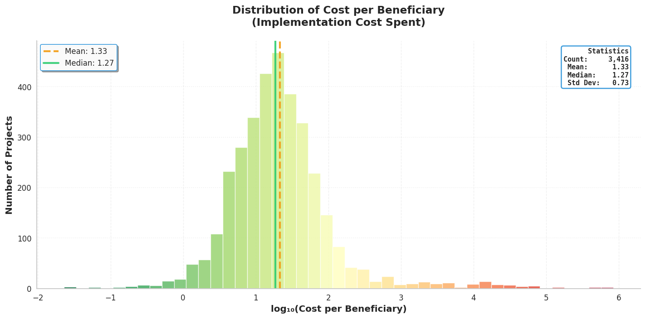
Notes:
“This chart shows the distribution of cost per beneficiary across all projects.
On a log scale, we see a clear right-skewed distribution. Most projects cluster around a relatively narrow efficiency band, but there is a long tail of very high-cost projects. These are not necessarily bad projects — but they deserve closer review.”

Slide 6
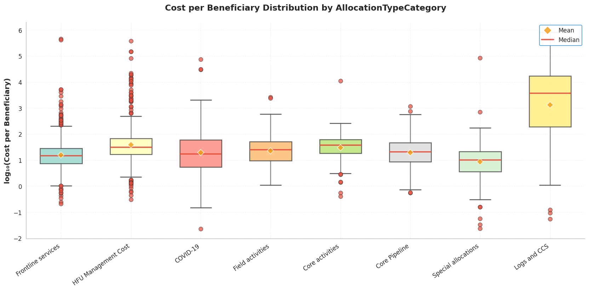
Notes:
“Here we break down cost per beneficiary by allocation type.
The medians differ substantially across categories, and so does the spread. For example, logistics-heavy or coordination-focused categories show higher median costs and wider variability than frontline service delivery. This tells us efficiency must always be interpreted within context.”

Slide 7
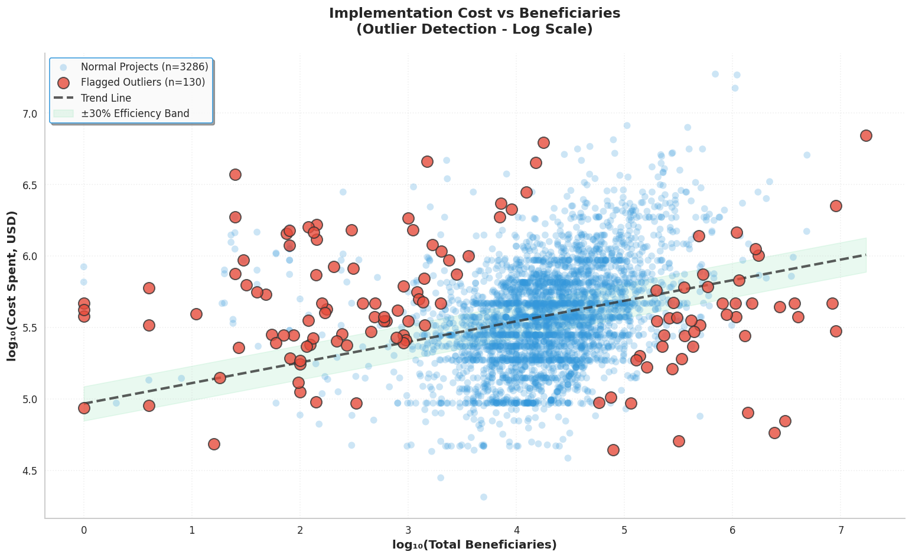
Notes:
“This scatter plot shows implementation cost versus beneficiaries reached.
Most projects fall within a predictable efficiency band. The highlighted points are statistical outliers — projects whose cost per beneficiary is unusually high or low relative to peers. These flags are not judgments; they are signals for further review.”

Slide 8

Regional & Cluster Efficiency Comparison
Certain regions and country-based pooled funds show high outlier rates
Median cost per beneficiary varies substantially by cluster
High outlier rates may reflect inefficiency or contextual constraints
Notes:
“Next, we look at efficiency across regions and country-based pooled funds.
Some regions consistently show higher outlier rates. Median cost per beneficiary also varies meaningfully by cluster. Importantly, high outlier rates may reflect inefficiency — or they may reflect conflict intensity, access constraints, or fragile infrastructure.”

Slide 9
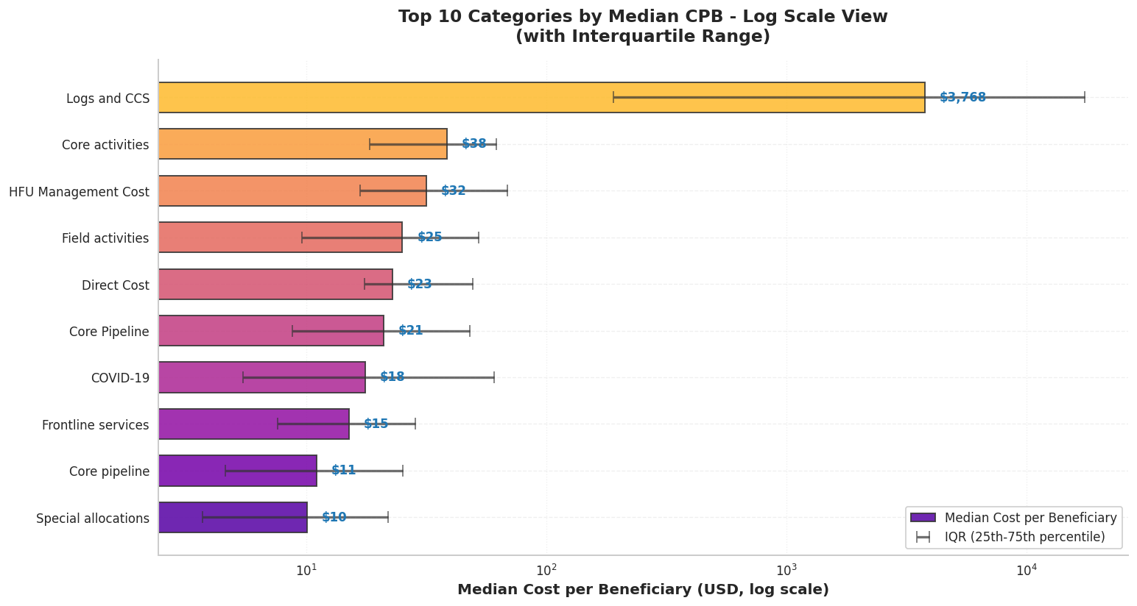
Notes:
This chart compares the top ten allocation categories by median cost per beneficiary, shown on a log scale to handle large differences. Each bar is the median, and the error bars show the interquartile range.
Logs and CCS stands out with a much higher median cost, reflecting fixed logistics and coordination costs, while frontline and pipeline services cluster around $10–20 per beneficiary, indicating more consistent delivery efficiency. This provides a clear, standardized benchmark for comparing efficiency across categories.

Slide 10
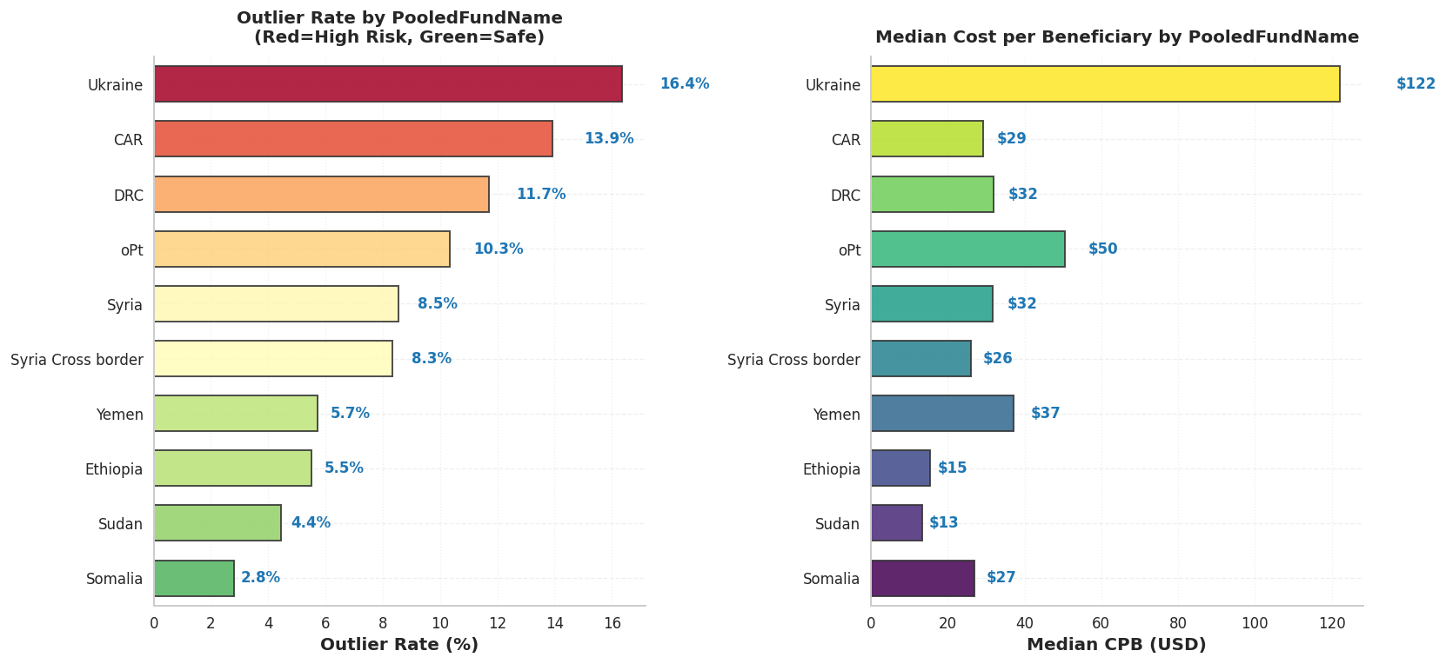
Notes:
“Here we focus on country-based pooled funds.
On the left, we see outlier rates; on the right, median cost per beneficiary. Some contexts — such as Ukraine — show both high median costs and high outlier rates, which is consistent with operating in high-intensity conflict environments. This reinforces why benchmarks must be contextual, not punitive.”

Slide 11

Donor Landscape & Global Context
Top CERF donors account for a large share of total contributions
Funding concentration contrasts with geographically diffuse humanitarian needs
Global donor map highlights unequal contribution patterns
Notes:
“We then zoom out to the global donor landscape.
A small number of donors account for a large share of total CERF funding. This concentration contrasts with the geographically diffuse nature of humanitarian needs. Understanding this imbalance is crucial for long-term resilience planning.”

Slide 12
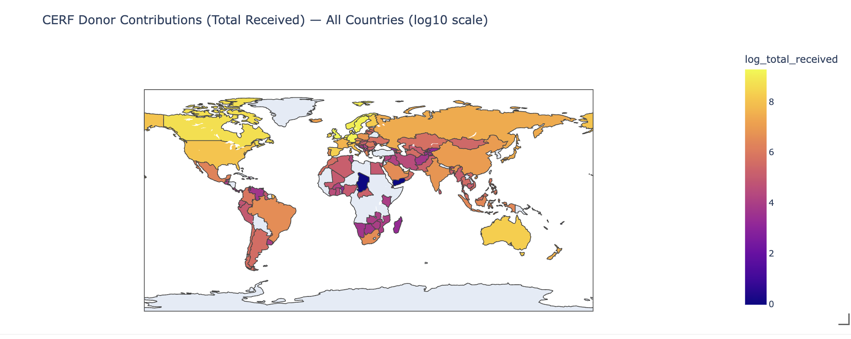
Notes:
“This global map visualizes total CERF donor contributions by country.
Contributions are highly uneven, with a small number of countries providing the majority of funding. This visualization helps contextualize funding capacity and global responsibility.”

Slide 13
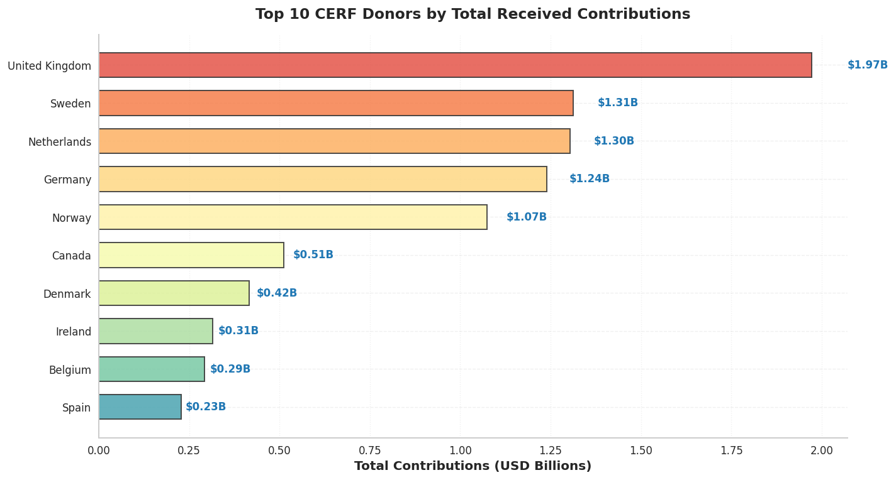
Notes:
“This chart highlights the top ten CERF donors by total contributions.
While these donors play a critical role, reliance on a narrow donor base introduces systemic risk. Diversifying funding sources could improve stability during global shocks.”

Slide 14
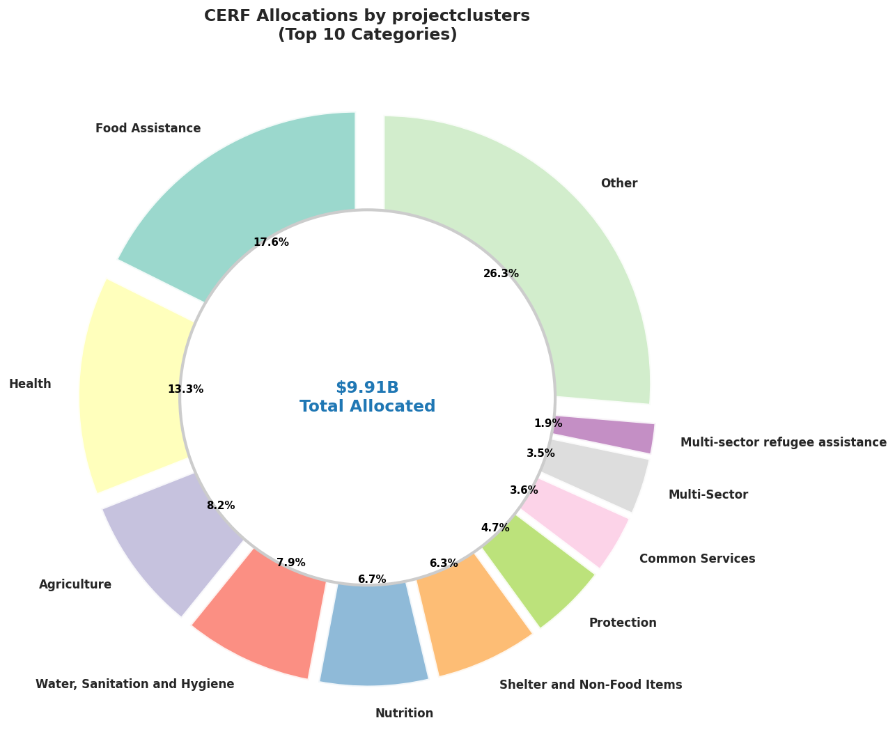
Notes:
“This chart shows how CERF funds are allocated across humanitarian clusters.
Food assistance and health dominate allocations, reflecting urgent humanitarian priorities. Linking these allocations with efficiency metrics helps ensure funds are not only well-intentioned, but well-deployed.”

Slide 15

Proposed Standardized Framework
Compute
Compute cost per beneficiary for all projects
Normalize
Normalize costs using log scaling and flag statistical outliers
Compare
Compare efficiency across clusters, regions, and time for monitoring
Notes:
“Based on our analysis, we propose a simple, scalable framework.
First, compute cost per beneficiary for all projects. Second, normalize using log scaling and flag statistical outliers. Third, compare efficiency across clusters, regions, and time.
This framework is transparent, data-light, and adaptable.”

Slide 16
Policy Implications & Conclusion
Enables evidence-based monitoring of humanitarian efficiency
Supports transparency, accountability, and adaptive allocation
Scalable, data-light framework with scope for contextual adjustments
Notes:
“To conclude, our framework enables evidence-based monitoring of humanitarian efficiency.
It supports transparency, accountability, and adaptive allocation — without oversimplifying complex realities.
Most importantly, it helps ensure that every humanitarian dollar reaches as many people as possible, as effectively as possible. Thank you.”

